Slide 1
Know your employment rights
Preventing Labour Abuse

Slide 2
Objectives
Understand your employment rights as a worker in the UK
Recognise the different rates of the National Minimal Wage and National Living Wage
Recognise examples of worker exploitation
Know who to contact for help and advice

Slide 3
Think?
Your employment rights in the UK
You are entitled to:
be paid the National Minimum Wage or National Living Wage
rest breaks of 20mins if you work more than six hours a day
paid holidays
an itemised payslip which shows your gross pay and take home pay. It should also list the amount and reason for any deductions taken from your pay.
a safe working environment
sick pay
a copy of your terms and conditions

Slide 4
Think?
Terms and Conditions
This is an agreement between you and your employer.
If you have been employed for more than one month you must be given written details of your terms and conditions.

Slide 5
Think?
Terms and Conditions
What information should be included?
Name
Who you work for
Type of work you will be doing
Date you started work
Place of work
Rate of pay
How often you will be paid
Hours of work
Holiday entitlement
Sick pay entitlement
Disciplinary procedures
Notice required if leaving

Slide 6
Think?
Hours of work
You should not have to work more than 48 hours per week including any overtime unless you have chosen to do so.
You are entitled to at least one day off per week or two days every two weeks.
If you work for more than six hours a day you should have a rest break of at least 20 minutes.

Slide 7
Think?
National Living Wage and the National Minimum Wage
The National Minimum Wage (NMW) is the minimum pay per hour most workers under the age of 25 are entitled to by law.
The government's National Living Wage (NLW) is the minimum pay per hour most workers aged 25 and over are entitled to by law.

Slide 8
Think?
Current rates April 2019
25 and over 21 to 24 18 to 20 Under 18 Apprentice
£8.21 £7.70 £6.15 £4.35 £3.90
Nb
The rates change every April.
Apprentices are entitled to the apprentice rate if they’re either:
aged under 19
aged 19 or over and in the first year of their apprenticeship

Slide 9
Discuss
How might an employer exploit you?
What kind of companies might exploit you?

Slide 10
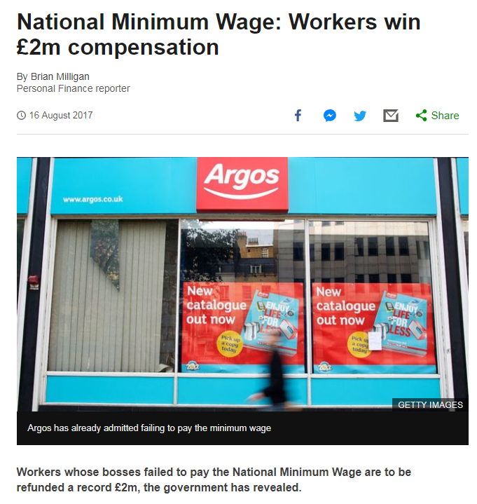

Slide 11
Who would you contact for advice or help?

Slide 12
Know your employment rights quiz?

