Slide 1

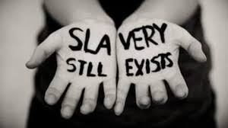
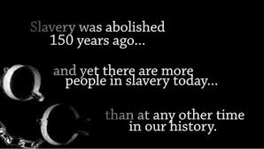



Modern Day Slavery
Preventing Labour Abuse

Slide 2

Objectives
Define Modern Slavery and Labour Exploitation.
Identify the different types that exist.
Explain how Modern Slavery works.
Recognise the signs and indicators of Modern Slavery and labour exploitation.
Know who to contact for help.

Slide 3

Think?
Discuss and come up with a definition of slavery?
A condition of having to work very hard without proper pay; working and living in poor conditions and having a lack of freedom.

Slide 4
Think?
How do you think people could be exploited?
There are many ways that people can be exploited – forced to work for little or no pay. Types of exploitation include:
Labour exploitation
Sexual exploitation
Domestic servitude
Organ harvesting
Criminal exploitation

Slide 5
Think?
Where might you come across Modern Day Slavery and Labour Exploitation in your local area?
Nail Bars, Car Washes, Agricultural Work, Fishing & Hospitality.
If the cost of the service is too good to be true, then it probably is.

Slide 6

Discuss
How could it affect you?
Contracts, minimum wage, hours of work, holiday pay, pension.

Slide 7

Think, discuss & watch
GLAA
What do you think the signs could be?
Now add to your list after watching below.
GLAA Modern Slavery

Slide 8

Spotting the signs….
No access to passports and ID documents, no contract, wages withheld, movements are controlled by another person, work excessive hours over long periods, forced to stay in a place you haven’t chosen, inadequate PPE, only travel with other workers, no access to medical care, poor and cramped accommodation, limited access to food, unable to communicate freely with others, owe a work finding fee, paid less than National minimum wage, subject to violence or threats of violence.

Slide 9
Rooney case
Research and find out -
What did the Rooney family do?
Where & when did it happen?
Who did the Rooney family target & why?
How long had this been going on?
What law did the Rooney family break?
What were the family members sentenced to?

Slide 10
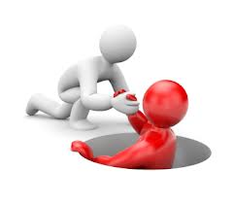
Modern Slavery Act 2015 – News
https://www.theguardian.com/uk-news/2018/jun/28/british-nurse-guilty-of-sex-trafficking-nigerian-women-to-germany

Slide 11



Who would you contact?

Slide 12

Play!
https://create.kahoot.it/details/modern-day-slavery-labour-exploitation/488d2e6e-b152-41ed-b34b-617dae1de0e8
Open in Chrome.

Slide 13
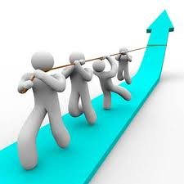
Taking it further
How would you check that you're not being exploited?
Check minimum wage.
https://www.gov.uk/national-minimum-wage-rates
Read your contract.

